Slide 1
More on dart functions
Common collection methods
Yousef Fawzi

Slide 2
Boo!
Anonymous functions in dart
An anonymous function is a function that has no name, but has a body, often referred to in other programming language also as a lambda function, like in python
Syntax:
(parameter_list) {
Statement(s)
}

Slide 3
void main() {
var list = ["Mona", "Ahmed", "Adel", "Peter"];
print("Techstream – anonymous function!");
list.forEach((item) {
print('${list.indexOf(item)} : $item');
});
}
//output
Techstream – anonymous function!
0 : Mona
1 : Ahmed
2 : Adel
3 : Peter
Exited.

Slide 4
Common methods
Most common collection functions
How to check if a list is empty or not? We use
The .isEmpty() to check a list
If a list is empty, it returns True, if not, it returns False
Note that .isNotEmpty() is the opposite

Slide 5
void main() {
var coffees = [];
var teas = ['green', 'black', 'chamomile', 'earl grey'];
print(coffees.isEmpty);
print(teas.isNotEmpty);
}
//output:
true
true
Exited.

Slide 6
Common methods
Most common collection functions
Where, any, every
Where searches for a value you specify, and returns the value.
Any is the equivalent of “or” function, if one element satisfies the condition, it returns true
every is the equivalent of “and” function, if ALL elements satisfy the condition, it returns true

Slide 7
void main() {
var teas = ['green', 'black', 'chamomile', 'earl grey'];
// Chamomile is not caffeinated.
bool isDecaffeinated(String teaName) => teaName == 'chamomile';
// Use where() to find only the items that return true
// from the provided function.
// Use any() to check whether at least one item in the
// collection satisfies a condition.
print(teas.any(isDecaffeinated));
// Use every() to check whether all the items in a
// collection satisfy a condition.
print(!teas.every(isDecaffeinated));
}
//output:
true
true

Slide 8
Common methods
Most common collection functions
The map function, applies either a named function you made, or built-in, or anonymous functions of your choice to an iterable i.e. lists, tuples, strings…

Slide 9
void main() {
List<int> numbers = [1, 2, 8, 4, 5];
List<int> doubledNumbers = numbers.map((number) => number * 2).toList();
print(doubledNumbers);
}
//output:
[2, 4, 16, 8, 10]

Slide 10
Common methods
Most common collection methods
Fold()
The fold function, operates on an iterable, to return a single value most of the time, the first parameter is for the initial value, and the second parameter is basically the anonymous function

Slide 11
void main() {
var words = ['I', 'love', 'techstream', 'training', 'program!'];
var nums = [1, 4, 9, 12, 5, 60, 121, 22, 9, 4, 9, 9];
int sum = nums.fold(0, (sum, i) => sum + i);
int mul = nums.fold(1, (mul, i) => mul * i);
String sentence = words.fold('', (j, i) => '$j $i');
print(sentence);
print(sum);
print(mul);
}
I love techstream training program!
265
1006006003200
Exited.

Slide 12
Common methods
Most common collection methods
Sort, to list, take, skip
The sort function just does what it says, it sorts an iterable
The to list() function puts the values into a list
The take function, takes first n values from an iterable and returns it
The skip, just skips the first n values from an iterable and returns it

Slide 13
void main() {
var numbers = [9, 5, 1, 3, 5, 7, 100, 69, 420, 70];
numbers.sort(); // Ascending
print("ascending: $numbers");
numbers.sort((a, b) => b - a); // Descending
print("descending: $numbers");
var names = ["sara", "adel", "aya", "ibrahim", "peter"];
List<int> evenList = numbers.where((number) => number % 2 == 0).toList();
print("the even numbers in the list are: $evenList");
List<String> firstThreeNames = names.take(3).toList();
print("the first 3 names are: $firstThreeNames");
List<String> remainingNames = names.skip(3).toList();
print("the remaining names are: $remainingNames");
}
ascending: [1, 3, 5, 5, 7, 9, 69, 70, 100, 420]
descending: [420, 100, 70, 69, 9, 7, 5, 5, 3, 1]
the even numbers in the list are: [420, 100, 70]
the first 3 names are: [sara, adel, aya]
the remaining names are: [ibrahim, peter]

Slide 14
Common methods
Most common collection methods
Indexes, joining, clearing, inserting and removing in an iterable
One of the most basic operations on iterables, that you will definitely use in your flutter project, the next code snippet is well commented, and you may skip this slide

Slide 15
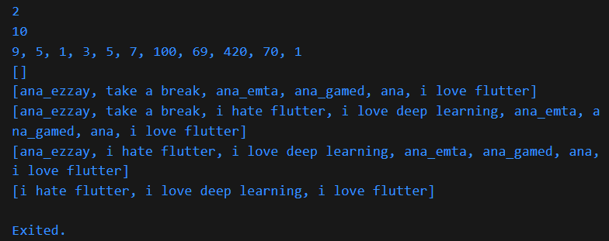
void main() {
var numbers = [9, 5, 1, 3, 5, 7, 100, 69, 420, 70, 1];
var ana_leh = ["ana_ezzay", "ana_emta", "ana_gamed", "ana", "i love flutter"];
int index = numbers.indexOf(1); //returns the first occurence of 1 in the list
print(index);
int lastindex =
numbers.lastIndexOf(1); //returns the last occurence of 1 in the list
print(lastindex);
String commaSeparated = numbers.join(', ');
print(commaSeparated); //return the list comma separated as a string
numbers.clear(); //clear the list, now the list is empty
print(numbers);
ana_leh.insert(1, 'take a break'); //insert the value into some position
print(ana_leh);
ana_leh.insertAll(
2, ['i hate flutter', 'i love deep learning']); //insert multiple values
print(ana_leh);
ana_leh.remove('take a break');
print(ana_leh);
ana_leh.removeWhere((task) => task.startsWith('ana')); //remove on condition
print(ana_leh);
}

Slide 16

that’s it! I hope you learned something new!
Dart documentation (and source):
https://dart.dev/language
My github:
https://github.com/Losif01/

